Slide 1

Program of Studies Meeting: Research Intro
Ricardo Jacome
Midwest Roadside Safety Facility
University of Nebraska-Lincoln
03/13/2020

Slide 2
Research Overview
On Road Coordinate Decomposition for Autonomous Vehicle (AV) Guidance
Main Motivation:
AV systems depend entirely on sensors for navigation
There is a need to find alternative solutions for this problem
General Objective:
Provide a road profile for AVs to navigate on a road, independent of vehicle sensors

Slide 3
Previous Work
Phase I: Literature Review + ABS Testing
Investigation on current AV technology
Evaluation of ABS performance testing
Emergency capacity of a vehicle
Phase II: Smart Barrier Methodology
Obtain a framework in which the road profile can be utilized
Road Profile Generation Framework
How to formulate road profiles
How to implement with current infrastructure

Slide 4
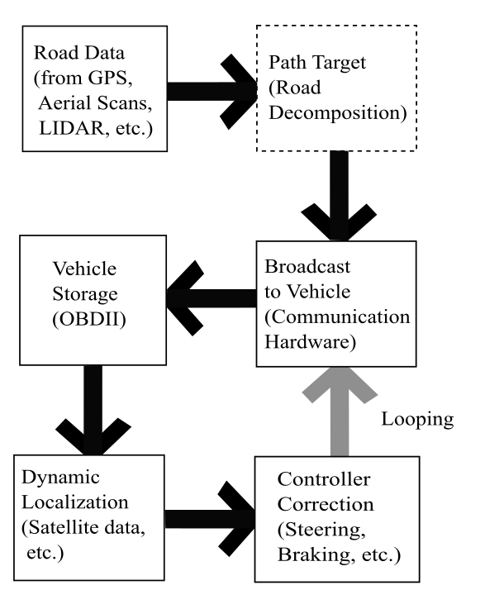
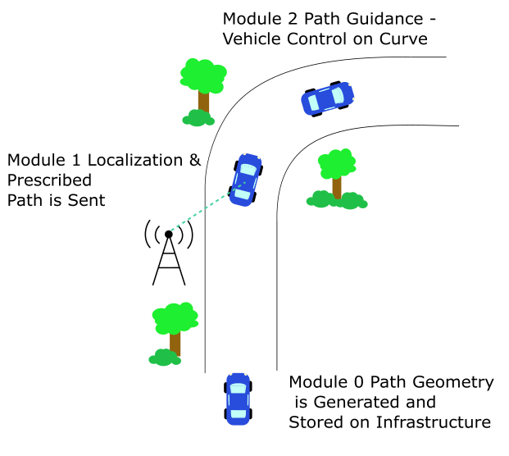
Road Profile in Overall Method

Slide 5
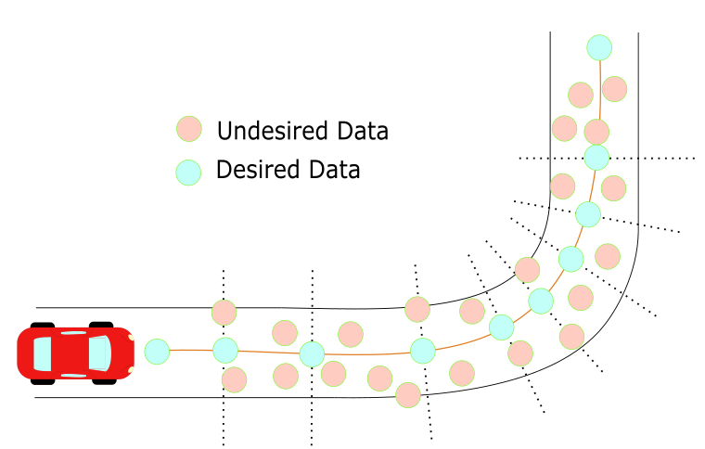
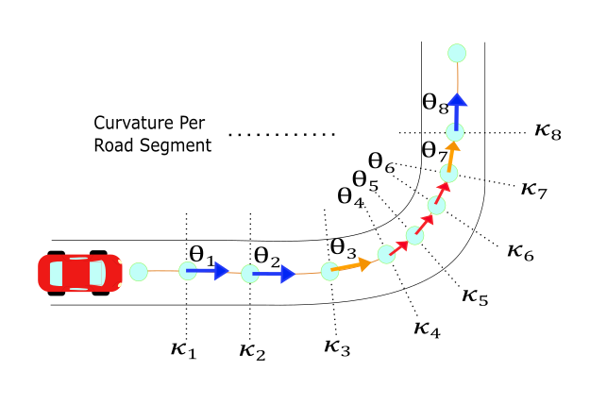
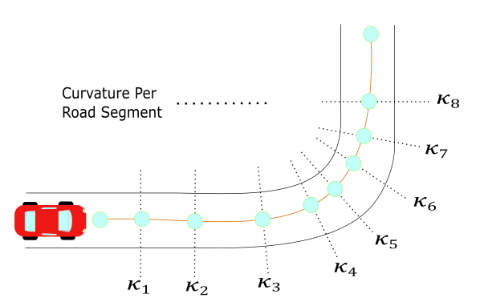
Sample Road Discretization

Slide 6
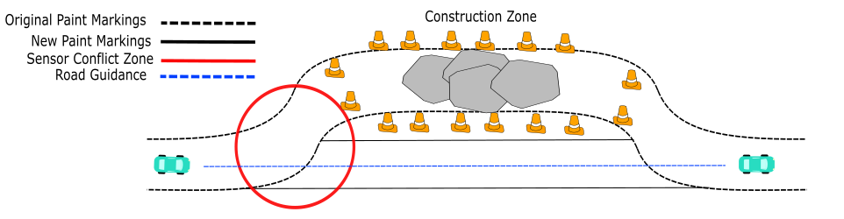
Implementation Example
This zone has conflict agreements in between the sensors and the vehicle Electronic Central Unit (i.e. steer or keep straight). Furthermore, weather factors such as rain, sand, or snow can increase the uncertainty of the vehicle to make decisions.

Slide 7
Current Work
ABS Acceleration Data, New Filtering Method Developed (Should I??????)
Road Profile Filtering/Smoothing
Data can come from multiple source
Satellite scans, GPS, lidar scans
Optimization Method for Road Profile
Selection of the best trajectory dependent on certain parameters
Current Velocity, Vehicle dimensions, Street Guidelines.

Slide 8
Termination Goal
A complete method to generate road profiles with the following characteristics:
Independent of data sources
Independent of most vehicle types
Some vehicles are not considered, for example Cargo Trucks, or Double Semi Trucks

Slide 9
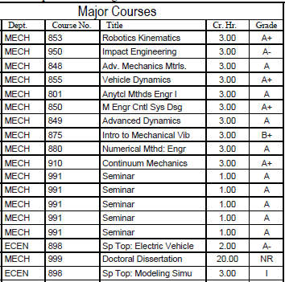
Program of Studies

Slide 10
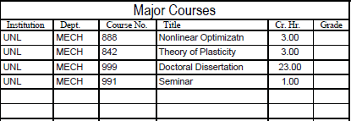
Program of Studies

